Slide 1
Territory Management
LEVEL – PL3
20-07-2023

Slide 2
About the Author
Created By: | Prashant, Sourav Bhattacharya, Supriyo Saha
Credential Information: | Consultant CRM, Sr. Consultant CRM – EAS Salesforce
Version and Date: | V 0.9 :20-July-2023, V1.0: July-2023:Updated with Lightning UI
Modified By: | Sneha Kate

Slide 3
Recap…
In the previous Module – Sample Management, you learnt to ...
  Define VEEVA Sample Management Data Model
  Define Sample Lot and Lot Catalog
  Explain various Sample Transactions
  Describe My Samples Tab
  Describe Sample Limit
  And now ...

Slide 4

Do You Know
  Account ownership and its effect on record sharing remains valid and unchanged when territory management is used
  Territory management only affects accounts and the standard objects that have a master-detail relationship to accounts

Slide 5

Objectives
After completing this chapter, you will learn to:
  Define VEEVA Data Model – Account Visibility/Territory Alignment & Territory Hierarchy
  Create Territories
  Define VEEVA’s Account Territory Loader (ATL)
  List out ATL Best Practice
  Describe Zip-to-Terr & Brick-to-Terr
  Work with Territory Fields - Product Alignment by Territory and Account

Slide 6
Territory Management
Data Model & Territory Hierarchy
20-07-2023

Slide 7
Data Model - Territory

Slide 8
Territory Hierarchy 1
An account is accessible by all users in the territories to which it is assigned, as well as those above them in the territory hierarchy
It is easy to build territory hierarchy by steps below
  Setup -> Manage Territories -> Hierarchy
  Controls visibility to accounts through the hierarchical structure
    Used to give reps access to their accounts
  Users assigned to a note can view accounts assigned to notes below in the hierarchy
  Navigate to a territory record to:
    View a list of accounts for that territory
    Add or remove an account from that territory
    Create a child territory
    Edit or Delete the territory

Slide 9
Territory Hierarchy 2
To access territory hierarchy, follow steps below
Setup -> Manage Territories -> Hierarchy
Territory Hierarchy can be expanded
and collapsed
Territory Node can be “Edit“ and “Delete”
from the Hierarchy
9

Slide 10
Creating Territories
Territories can be built through:
Provides a visual representation of the hierarchy and often makes building territories easier
User Interface
Import to the Territory object
Change Account Access Level to View/Edit (Setup > Manage Territories > Settings)
Apex Data Loader
10

Slide 11
ATL vs. Zip-to-Terr
Account Territory Loader | Zip-to-Terr (Brick-to-Terr)
Number of accounts exceeds ~1Million The alignment needs to go to many different systems Data Warehouses, Marketing Automation, Incentive Comp, etc. Complicated alignment rules Alignment is done externally and fed into various systems including VEEVA | Number of accounts less than ~1Million The alignment is mainly for the VEEVA system as it stands Rules only span VEEVA Account table Uncomplicated alignment rules Alignment is done inside VEEVA
11

Slide 12
Territory Management Application
  It is helpful to build a territory management application
    - Setup -> Create -> Apps
  Make visible only to System Administrator and Territory Administrator profiles
  Tabs to include:
    My Accounts
    Territory Utilities
    My Setup
    VEEVA (VoD) Messages
    Account Territory Loader (if using ATL)
12

Slide 13
Territory Management
Account Territory Loader(ATL)
20-07-2023

Slide 14
Account Territory Loader 1
  Account Territory Loader object is a tool to perform manual assignments of account to territories via a back-end data load
  Inserting a row into Account Territory Loader performs two operations:
    Removes the current territory assignment for associated Account
    Assigns the account to the specified list of territories explicitly
  ATL will set Account Territory alignments as specified during the data load

Slide 15
Account Territory Loader 2
  Recommended for implementation with 500K + accounts
  Processes faster than zip-to-terr
  Runs through the Apex Data Loader
    Creates a file with the SFDC Account ID and the territory(ies) to which the account will be assigned
    Inserts (initial load) or Updates/Upserts (ongoing) the file into the Account Territory Loader object

Slide 16
Account Territory Loader 3
  When inserting / updating a record into the ATL object:
  Checks Territory to Add and Territory to Drop and adds or removes territories from the Territory field
  Clears the Account Share records that correspond to the current Territory assignment
  Assigns the territory to the account

Slide 17
ATL Steps 1
Load Territory object with the correct territory hierarchy information
Territory Hierarchy
Load Accounts into the Account object
Accounts
Extract the Account SFDC ID from Account object using Data Loader
Account SFDC

Slide 18
ATL Steps 1
Extract the Account Territory Loader object to obtain the field names for import
ATL Field Names
Import the ATL file into the ATL object with the Account_vod__c, External_Id_vod__c, and Territory_vod__c columns populated
ATL

Slide 19
ATL File 1
Following Columns are required in ATL Load file to execute the alignment
Account_vod__c External_ID_vod__c Territory_vod__c
Territory_to_add_vod__c Territory_to_drop_vod__c
Account_vod__c | External_ID_vod__c | Territory_vod__c
This is a lookup to the Account object Contains the SFDC Id for the account | The external ID for updating or upserting into the ATL object after the initial load Best Practice: use the Account SFDC Id | Stores the territories associated with this account in a semicolon separated format Salesforce.com territory rules later run on this field to assign territories A leading and trailing semicolon must be contained within this field ;LA123;NYC321;US3244;

Slide 20
ATL File 2
Territory_to_Add_vod__c | Territory_to_Drop_vod__c
Contains a semicolon delimited list of territory names Used to assign one or more territories to the account for incremental alignments If values are listed, territory names will be added to the Territory_vod field | Contains a semicolon delimited list of territory names Used to remove one or more territories from the account for incremental alignments If values are listed, territory names will be removed from the Territory_vod field

Slide 21
ATL Best Practices
There should only be one ATL record for each account
External ID must be 18 digit and value of account ID and external ID are same
For subsequent loads for incremental or full alignments, perform an UPSERT on the ATL object based on the External ID
Utilize Territory List for full alignment load. Admin should use the Territory to Add and Territory to Drop fields to simplify single add and remove operations

Slide 22
Brick- to-Terr 1
Setup -> Create -> AppsSimilar to Zip-to-Terr
  Certain countries / regions assign Accounts to territories based on a brick number stored on the Address objects
  Bricks are non-standard geographical groupings of Accounts
Uses VEEVA’s Territory Utilities to assess the child Address object and populate data at the Account level
One Account can have n-number of addresses
Not ideal if number of accounts is greater than 500K
Brick_to_Terr_vod object stores mapping of Bricks to Territories
  - Data in custom fields will be automatically copied over to the Account or Person Account records if the field names are identical

Slide 23
Brick- to-Terr 2
Brick_Hierarchy_vod object stores relationships of bricks to one another
  Bricks to Bricks
  Mini-Bricks to Bricks
  Name field = name of the Brick
  Territory_vod field = territory to assign Addresses to
Territory_vod__c field only allows 255 characters (including semicolons)
Territory Hierarchy must be established
Add Brick_vod__c field to Address page layouts for Admins
  Load the Brick Name the Address is aligned to in this field

Slide 24
Brick- to-Terr 3
Following are the Steps for Brick-to-Terr alignment:
  Upload Brick Hierarchy file
  Upload Brick-to-Terr file
  Create rules for the alignment
  Run test assignment
  Run reports on the alignment
  Run mass assignment
  Use Manual Overrides until next realignment

Slide 25
Brick- to-Terr Process Alignment
  Test Territory Assignment
    Use to determine if territories will map correctly prior to finalizing territory assignments
    Populates Territory_Test_vod__c field on Account object
      Maximum of 255 characters
      Only administrators should have View access using Field Level Security
  Mass Assign Territories
    Run after running Test Territory Assignment
    Populates Territory_vod__c field on account object
  – Maximum of 255 characters
  – Only administrators should have View access using Field Level Security
  Determining which Addresses to include in alignment:
    Primary Addresses are included
    To include a non-primary Address
  Set Include_in_Territory_Assignment_vod__c field to “True”:
    To prevent an Account from being included in alignment
  – Set Exclude_from_Zip_to_Terr_Processing_vod__c field to “True”

Slide 26
Archiving Accounts
Retired / Deceased Accounts:
  -- Person account either retires or is deceased
    Reassign account to an "Inactive" territory
    Preserves historical data and removes it from active territories
    Create fields on Account object
Workflow triggers email for administrator to move account to “Inactive

Slide 27
Mixing ATL with Zip/Brick-to-Terr
  Using both Account Territory Loader with Zip-to-Terr can be used when…
    Most accounts use rule-based territory assignment
    AND
    Some accounts (i.e., Payers) require manual assignment to territories
Caution: Maintaining two territory management models is complex!

Slide 28
Territory Management
Territory Fields
20-07-2023

Slide 29
Territory Specific Field(TSF)
  Users must have read access to the TSF_vod object in order to display the territory management section. The Edit button displays only if the user has Create and Edit rights to the TSF_vod object. For subsequent loads for incremental or full alignments, perform an UPSERT on the ATL object based on the External ID
  Record Types for Territory Specific Fields are supported Online, on iPad, Windows 8, and on VEEVA CRM Mobile Tablet Edition
  In order to utilize this functionality, create a TSF Record Type exactly as the Record Type of the TSF’s associated account. By introducing Record Types, a customer can view different page layouts when viewing the TSF record on the Account page layout based on the type of account that is being viewed. Updating of the Account Record Type will automatically trigger the update of the TSF records that are associated with that account
  The following fields will not display on the page layout for the Territory section:
    Created By
    Last Modified By
    Account
    Territory_VoD

Slide 30
Product Alignment by Territory & Account
  The Allowed Products field on the Territory Specific Fields object allows customers to control which products can be discussed by users (territories) to specific Accounts within the VEEVA CRM application. This flexibility allows organizations, with parallel sales teams, to appropriately align and target Accounts with targeted product messaging. By populating a product or multiple products into the Allowed Products field on the TSF record, a user aligned to the Territory and Account of the TSF record will only be able to select the defined products when recording their calls against the Account
  The Allowed Products field controls the User’s ability to select Details, Samples, BRCs, and Promotional Items on the Call Report page

Slide 31
Territory Fields – Online 1
  The Territory Field custom object (TSF_vod) stores data specific to an account and territory relationship. Many of the fields in this object are auto-populated from other processes; therefore, you cannot delete or modify any of the fields. You can, however, add your own fields to this object
  At the end of the Account Wizard, if TSF fields were required on the page layout, one row in the Territory Field object is automatically created for each territory on each account profile by one of the following:
    During Mass Update of a field in the Territory Field object, such as Route
    After creating a call on that account
    At the end of the Add New Record Type Wizard process

Slide 32
Territory Fields – Online 2
  When these records are created, the TSF Name field populates with the Territory ID. Users can change the name
  The YTD Activity and Last Activity Date fields on the Territory Field object are updated by a trigger on the Call object. Last Activity Date is set to the value of Call Date on the call, and YTD Activity is incremented by one. The trigger also maintains the My Preferred Address field on the Territory Field object by stamping it with the address on the call. Updates to the Territory Field object are performed only when the account and territory combination on the Territory Field record matches the assigned territory and account on the call

Slide 33
Territory Fields Prerequisites
  The Territory Field custom object (TSF_vod) stores data specific to an account and territory relationship. Many of the fields in this object are auto-populated from other processes; therefore, you cannot delete or modify any of the fields. You can, however, add your own fields to this object
  In order to utilize Territory Fields within the VEEVA CRM application, the following is required:
    Territory Management must be enabled and established within the org
      Territory Management Rules
      Manual assignment
    Users must have Read/Create/Edit access to the Territory Field object
    Users must have Read access to the Address object
  The unique key on the Territory Fields object is the concatenation of Account and Territory. A trigger is in place that prevents the creation of duplicate Territory Field records. The user will receive an error message if they attempt to create a duplicate record

Slide 34
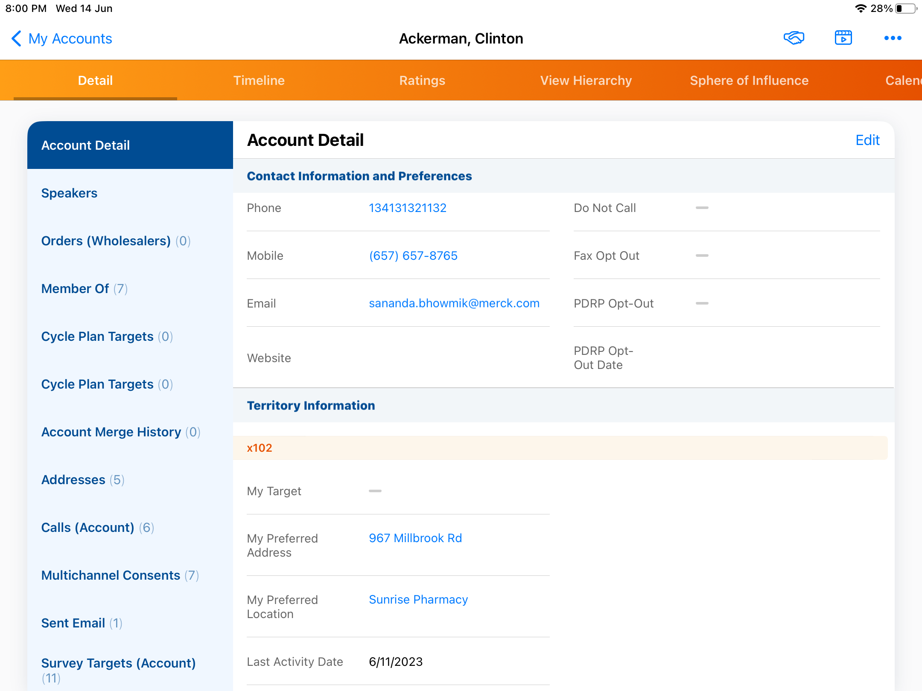
Territory Fields – CRM for iPad
  CRM for iPad supports the ability to display territory specific fields inline on the account detail page. The underlying data is relevant to the account and the territory, so users in disparate territories who share accounts can see different values. The fields displayed can also be tailored by account record type. Territory Specific Fields can be edited offline so users can change the relevant data

Slide 35
Territory Fields – Windows
  The user sees default territory specific field (TSF) object entry displayed within the Account Details page. The layout of the TSF entry will match the layout displayed online

Slide 36
Check Your Understanding ... 1
1. If you implement Territory Management, your role hierarchy
will be copied to your Territory structure
True
False
Answer: False

Slide 37
Check Your Understanding ... 2
2.Where do you go to enable Territory management?
Name | Setup | Customize | Territory Management | Settings Enable customizable forecasting
Name | Setup | Manage Territories | Settings
Name | Setup | Company Information | Territory Management | Settings
None of the Above
Answer: Name | Setup | Manage Territories | Settings

Slide 38

Summary
  In this module, you have learnt to,
  Describe Account Visibility/Territory Alignment-Data Model
  Define territory management
  Define account territory loader and territory specific field
  Describe Zip-to-Terr
  Describe Brick-to-Terr

Slide 39
Source
https://trailhead.salesforce.com/en/modules/sales-territories-and-forecasting/units/learn-territory-management-best-practices
https://crmhelp.veeva.com/doc/Content/CRM_topics/Accounts/Territory_Management/Territory%20Management.htm?Highlight=territory%20management
Disclaimer: Parts of the content of this course is based on the materials available from the Web sites and books listed above. The materials that can be accessed from linked sites are not maintained by Cognizant Academy and we are not responsible for the contents thereof. All trademarks, service marks, and trade names in this course are the marks of the respective owner(s).

Slide 40
Coming Next ...
In the upcoming Module, Reports and Dashboards, you will learn to ...
  Build reports and dashboards so that you could monitor and analyze your business data
  Explain the difference between a Report, Dashboard and Report Type
  Identify the limitations of VEEVA Reports and Dashboards

Slide 41
Thank you
  You have successfully completed
  Territory Management

